Slide 1

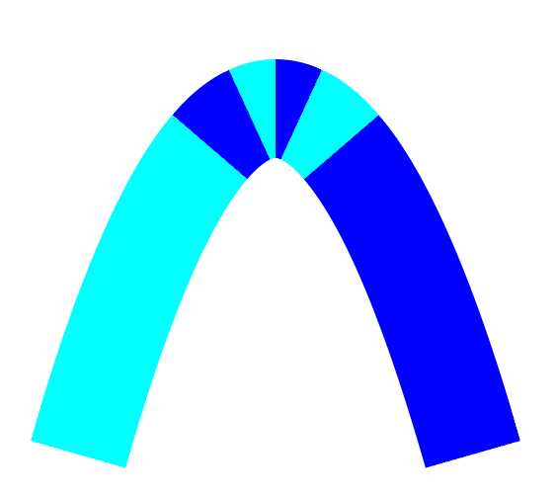
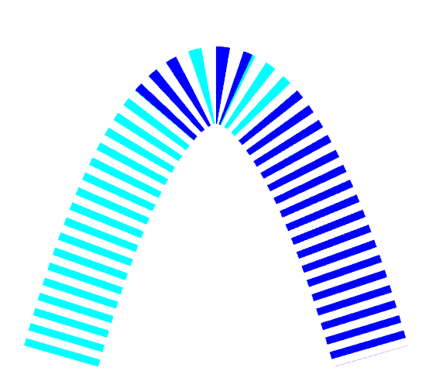
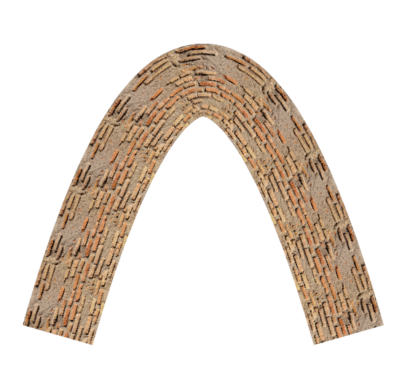

GPU-Accelerated Rendering of Vector Strokes with Piecewise Quadratic Approximation
Xuhai Chen, Guangze Zhang, Wanyi Wang, Juan Cao, Zhonggui Chen†
Xiamen University
Notes:
My name is Xuhai Chen. Today, I'll be presenting the paper GPU-Accelerated Rendering of Vector Strokes with Piecewise Quadratic Approximation, which is a joint work between myself, Guangze Zhang, Wanyi Wang, Prof. Juan Cao and Prof. Zhonggui Chen from Xiamen University.

Slide 2



Introduction
Raster image: a grid of pixels with specific colors
Vector image: defined by geometric primitives
Resolution independent by appropriate rendering method
Raster image
Vector image
Notes:
A raster image is made up of a grid of pixels, each with specific colors. You can observe a saw-toothed shape when you zoom in.
On the other hand, a vector image is defined by geometric primitives, making it resolution independent as long as the rendering method is appropriate.

Slide 3
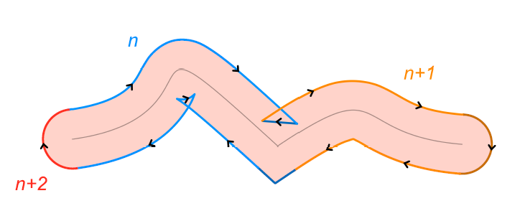
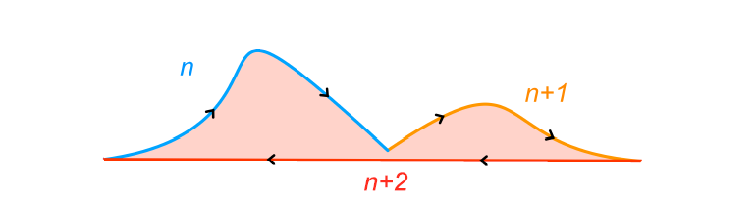
Introduction
Primitive in vector graphics: path
Two styles of a path: stroke and fill
Path: an outline
Stroke: trace the outline with a brush
Fill: color between the outlines
Our focus
Stroke
Fill
Notes:
The primitive in vector graphics is called path and there are 2 styles of a path stroke and fill. We a path is an outline and if you trace the outline with a brush you’ll get a stroke and if you color between the outlines you get a fill. Our primary focus is on stoke rendering.

Slide 4
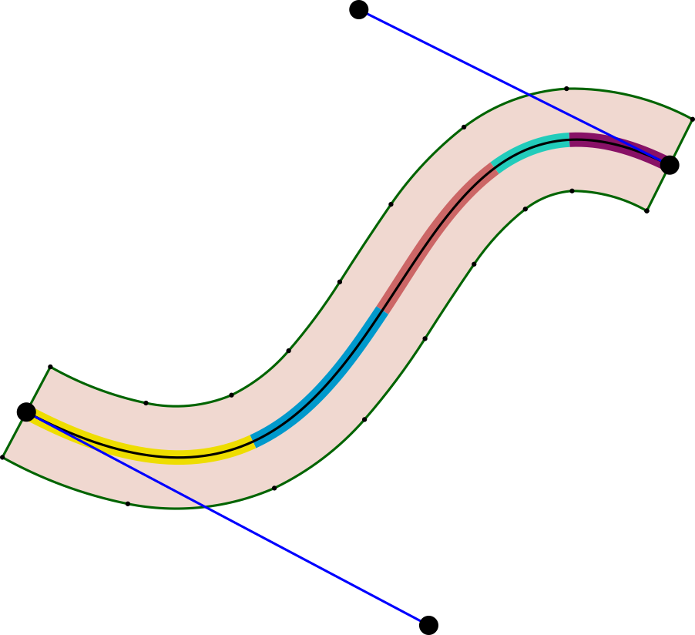

Introduction
Stroke region: area bounded by two offset curves and straight edges
Offset curve at a distance 𝑑 from $g\left(t\right)$:
$$O\left(t\right)=g\left(t\right)+dn\left(t\right),t∈[0,1]$$
$n\left(t\right)$ is unit normal
Offset curves are much more complex
Stroke rendering is more challenging than fill
Idea: convert strokes to fills
Notes:
The stroke region is the area bounded by two offset curves and two straight edges. For a planar curve g(t), you can generate an offset curve by moving each point along the unit normal direction by a distance d. In general, offset curves are much more complex than the original curve, which makes stroke rendering more challenging than fill rendering. A common strategy is to convert strokes into fills to simplify the rendering process.

Slide 5









Introduction
Bézier curve of degree $n:$
Example: quadratic and cubic curves
$$B\left(t\right)=\sum_{k=0}^{n}{\left({n \atop k}\right)t^{k}{(1−t)}^{n−k}}P_{k}$$
$$P_{2}$$
$$P_{1}$$
$$P_{0}$$
$$P_{0}$$
$$P_{2}$$
$$P_{1}$$
$$P_{3}$$
Quadratic Bézier curve
Cubic Bézier curve
Notes:
I will introduce the fill path rendering method we used for Bezier curves. A Bezier curve of degree n is defined by this formula, and their shape is largely decided by control points. The most commonly used bezier curves are quadratic and cubic curves.

Slide 6
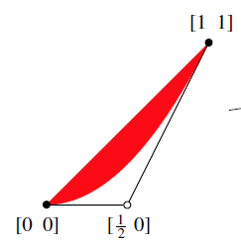
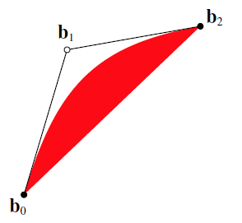



Introduction
Implicit equation-based filled path rendering [Loop et al. 2005]
Standard quadratic curve: control points $P_{0}=\left(0,0\right),P_{1}=\left(0.5,0\right),P_{2}=(1,1)$
$B\left(t\right)=(t,t^{2})$, satisfies the equation ${f\left(u,v\right)=u}^{2}−v=0$
$$f\left(u,v\right)<0$$
Affine Transform
$$f\left(u,v\right)>0$$
Inside region of standard curve(Red)
General case is reduced to standard case by affine transform
Notes:
A classic method to render filled region of Bezier curve is the implicit equation based filled path rendering by loop at al.
Starting with the standard quadratic curve whose control points are given specifically, it satisfies the equation u square minus v equals 0 in the uv space. By evaluating u^2 - v we know the pixel (u,v) lies inside B(t) if the value is less than 0. The method extends to general quadratic Bezier curve by affine transform.
The filled path rendering method is designed for quadratic curves. In order to apply the filled path rendering, we approximate the offset curves by quadratic curves.

Slide 7
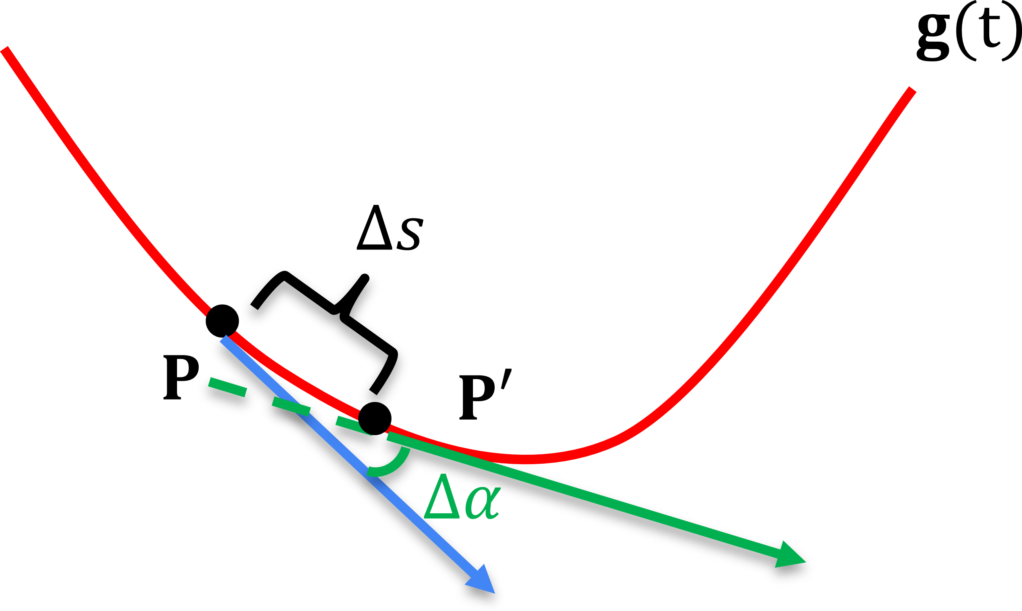
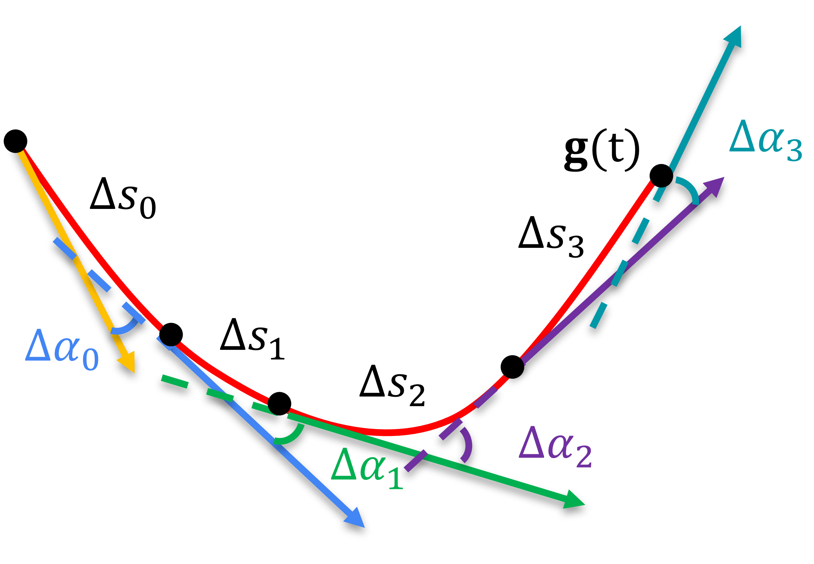
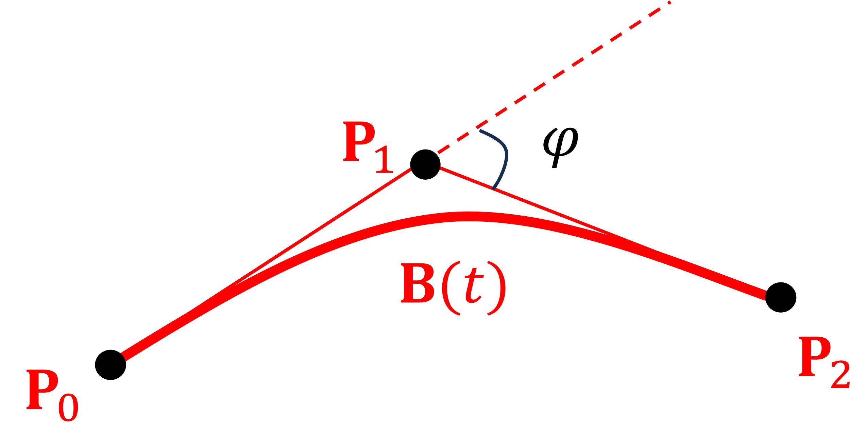

Introduction
Curvature of $g\left(t\right)$ at$P$
$κ=\lim_{Δs→0}\frac{Δα}{Δs}$ is change rate of tangent angle
$\int_{0}^{s}{κds}=\int_{0}^{s}{\frac{dα}{ds}ds}=\int_{0}^{s}{dα}=φ$
$φ:$ angle between$g′(0)$ and $g′(1)$, the “turning angle”
Notes:
And this approximation accuracy is mainly controlled by the curvature. Well, the curvature is basically the change rate of tangent angle. More specifically the accuracy is controlled by the integral of the curvature, which has a very clear geometric meaning as the turning angle, the angle of start velocity and end velocity.

Slide 8
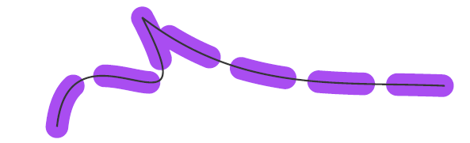
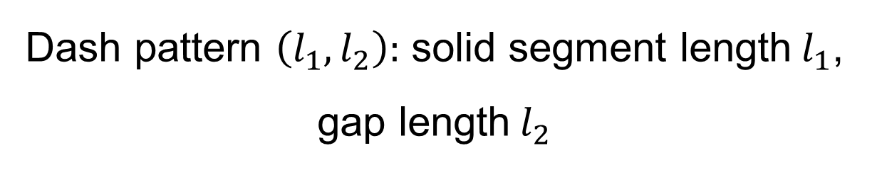

Introduction
Dashing style is described by arc-length
Requires arc-length parametrization
Arc-length function $s\left(t\right)=\int_{0}^{t}{|g′(τ)|dτ}$, with inverse $t=t\left(s\right)$
Key problem: how to solve $t=t\left(s\right)$
Dash pattern $\left(l_{1},l_{2}\right):$ solid segment length$l_{1}$, gap length$l_{2}$
Notes:
Apart from basic stroke rendering we also consider the dashed stroke rendering, which is defined by l1 l2. l1 specifies the solid segment length and l 2 specify the gap length between 2 solid segments. Though intuitive, this arc length description must be converted into the Bezier parameter t which lies between 0, 1 for later Bezier curve evaluation. The problem is to invert the accumulated arc length function.

Slide 9
Introduction
We propose a GPU-accelerated rendering method of quadratic strokes
Efficiency of implicit equation-based rendering
Accuracy of curvature-guided adaptive subdivision
We develop an efficient arc-length parameterization method
Newton iteration with proved fast convergence
Applications: dashed strokes rendering and arc-length-guided texture filling
Notes:
Our contributions include: we propose a gpu accelerated rendering method of quadratic strokes which combines the efficiency of implicit equation based rendering and accuracy of curvature guided subdivision
.
We also develop an efficient arc length parameterization method for quadratic curves. It’s based on newton iteration with proved fast converging speed. As an application, it enables accelerated dashed strokes and arc-length guided texture filling。

Slide 10
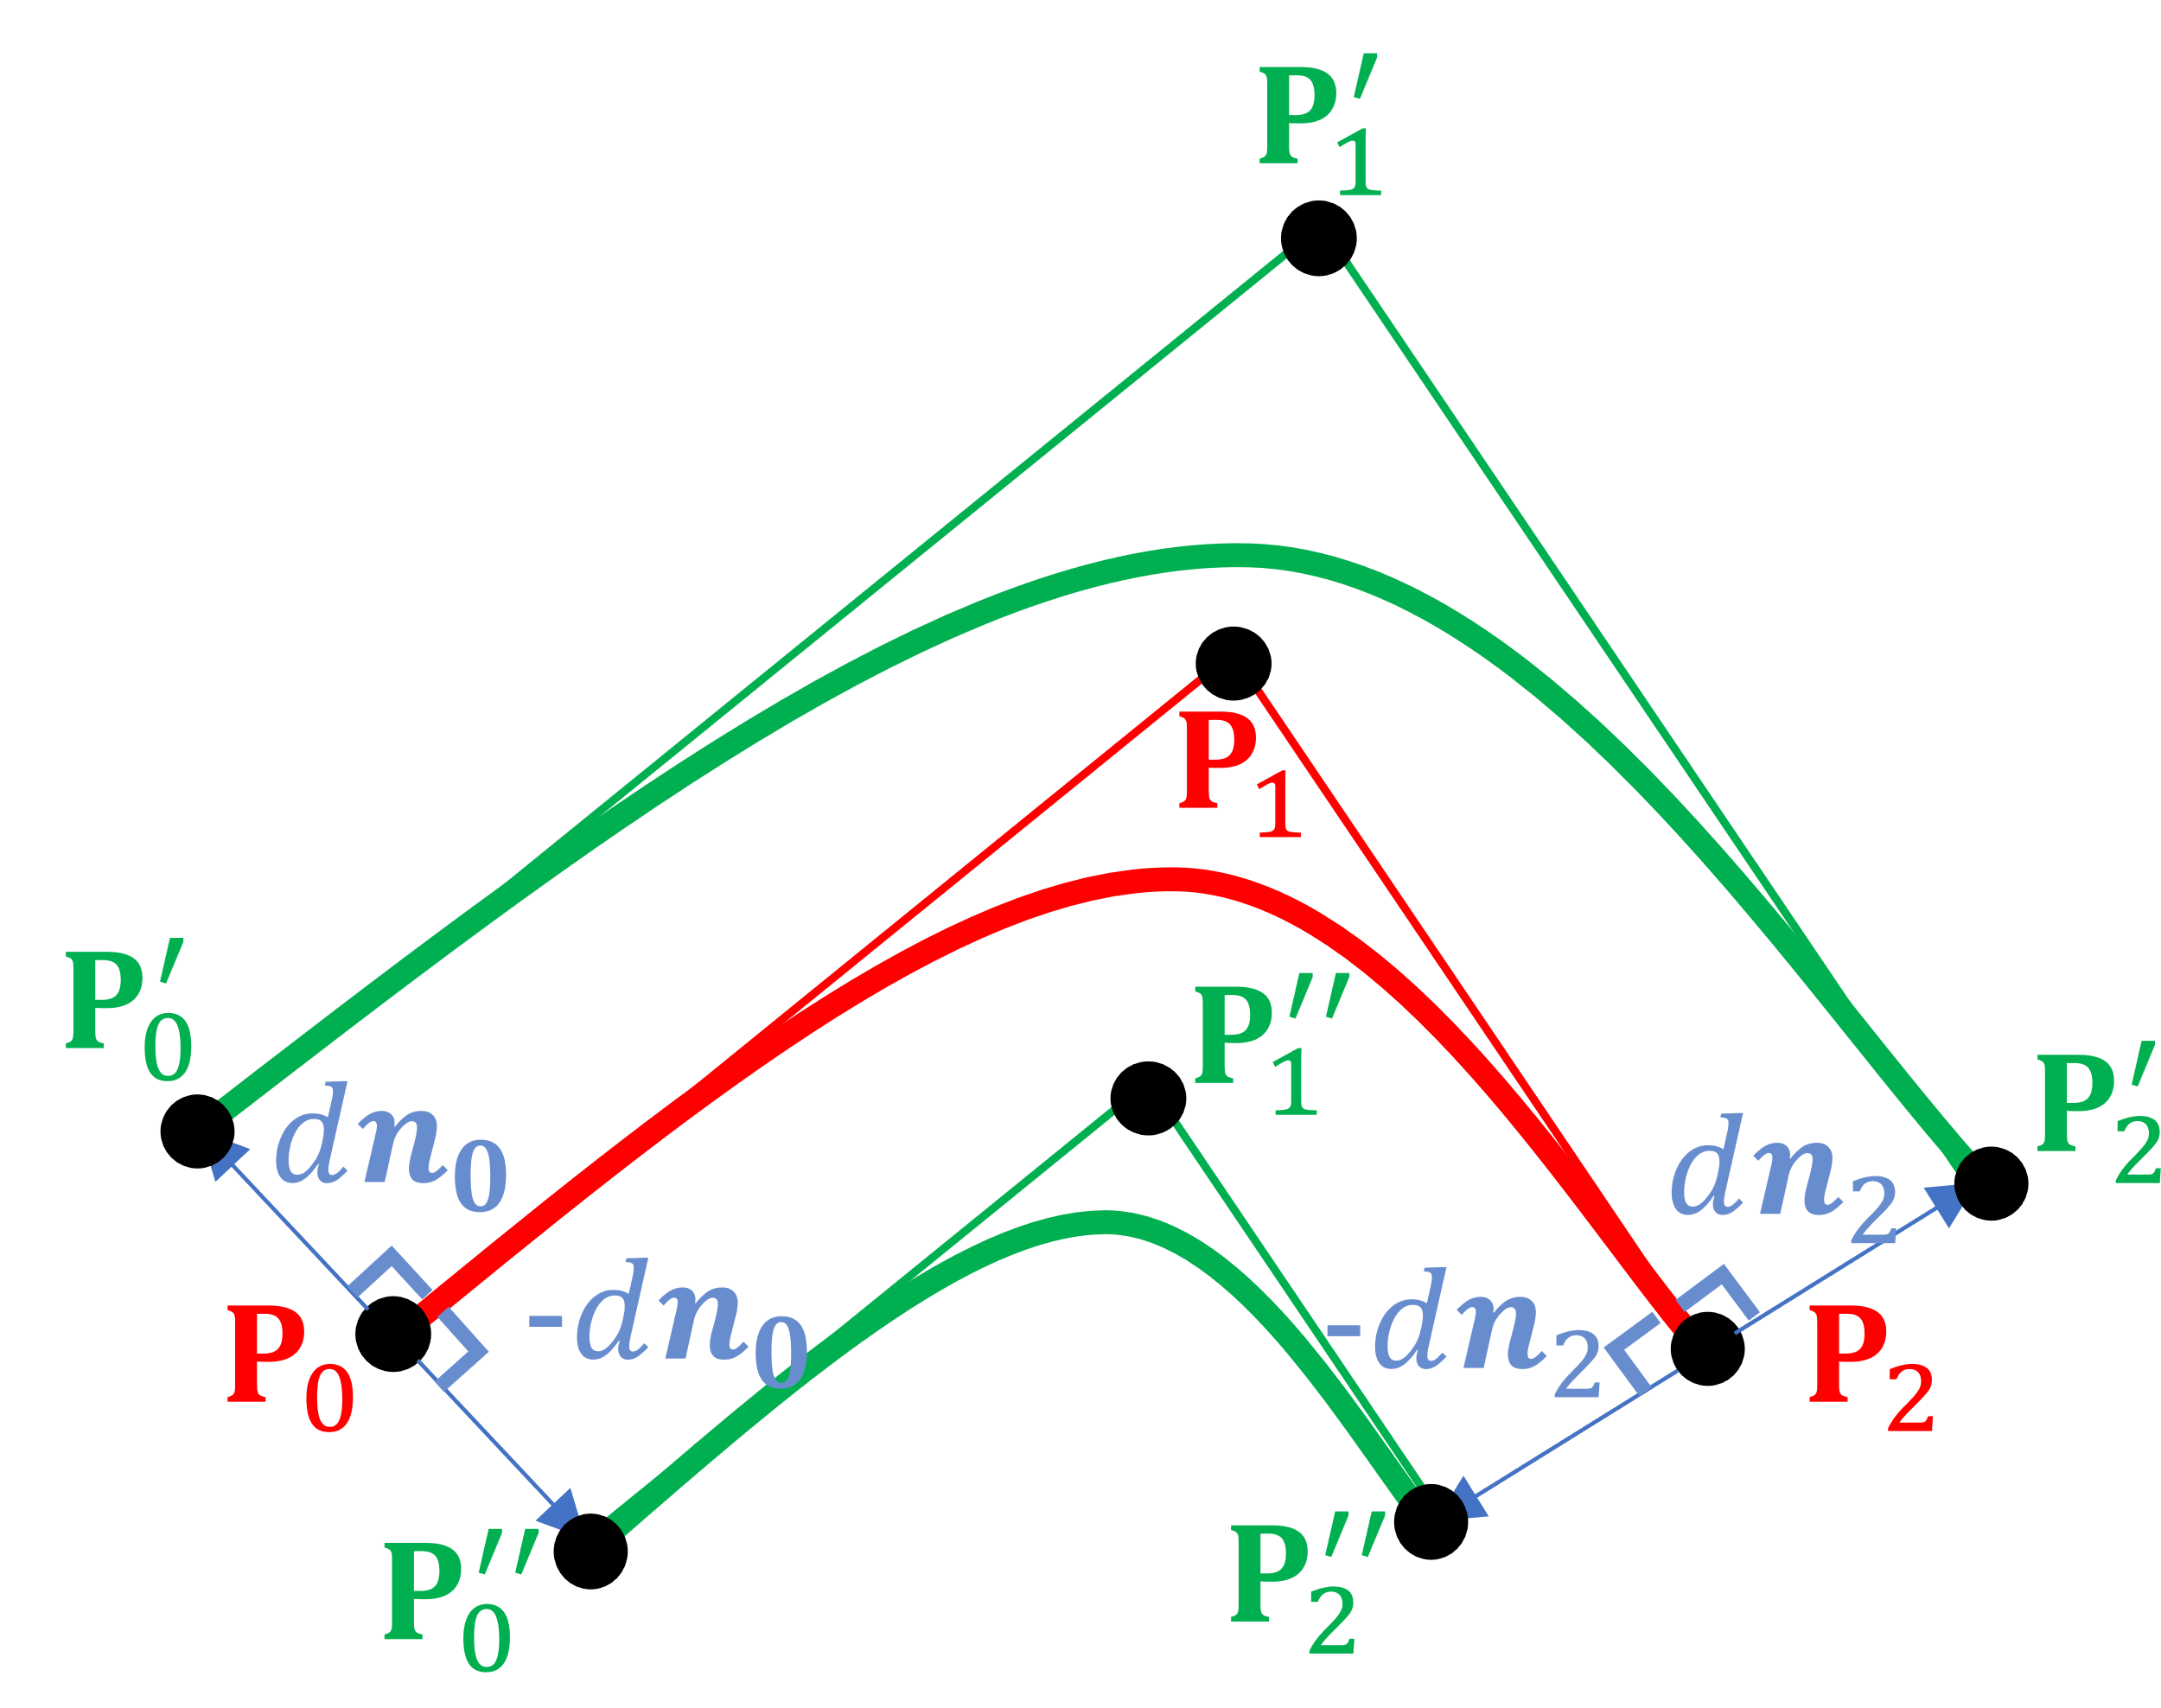
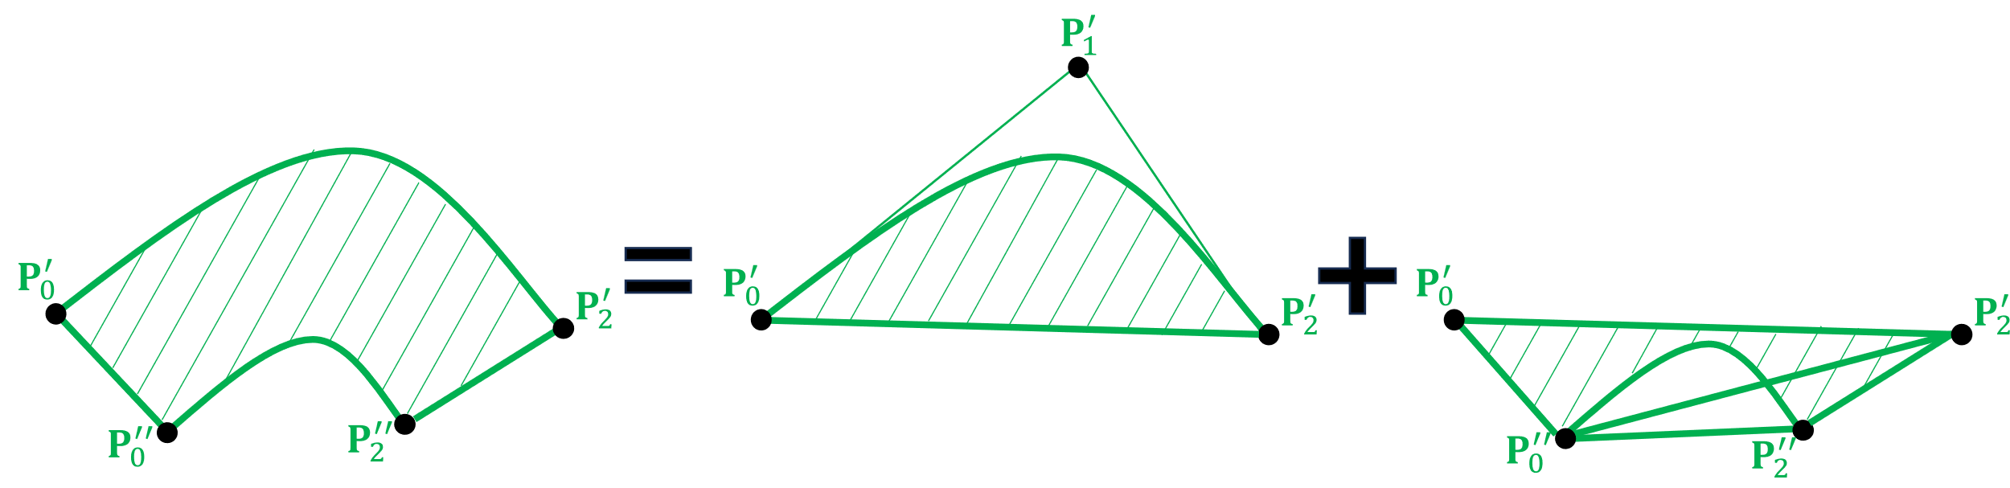
Method: Stroke Region Rendering
Focus on stroke regions of quadratic curves
Applicable for piecewise quadratic curves rendering
Fit offset curves by quadratics
Implicit equation-based rendering
Approximated stroke region
Implicit equation-based rendering
Notes:
Our method focuses on stroke regions of quadratic curves and is applicable for piecewise quadratic curves rendering. We fit offset curves with quadratic curves to enable the use of the implicit equation-based rendering for quadratic curves.
The approximated region looks like this. The red curve is the path being rendered, and its offset curves are approximated by quadratic curves whose control points are formed by translating the original control points along the normal direction.
We use three triangles, which are generated by the geometry shader, to cover the stroke region and we discard the pixels outside the region in the fragment shader to obtain the stroke region shape.

Slide 11

Method: Curvature-Guided Subdivision
Error analysis for offset curve fitting
Relative error: $η=\max_{t∈[0,1]}{\frac{|\hat{d}\left(t\right)−d|}{d}}$
$η=\frac{2\sin^{4}{(\frac{φ}{4})}}{\cos{(\frac{φ}{2})}}$ [Yzerman 2020], $φ$ is turning angle
Subdivision into quadratic subcurves with $φ≤\frac{π}{6}$
Absolute error $≤$ 0.03 pixels
Notes:
There is a well established error analysis which says the relative error of this approximation is only dependent on the turning angle. And this is a monotonically increasing function, which says the flatter the curve is the more accurate the approximation is. So we subdivide the original curve into subcurves with bounded turning angle to guarantee the absolute error to be less than 0.03 pixels.

Slide 12









Method: Curvature-Guided Subdivision
$$P_{1}$$
Subdivide into $K=\left\lceil \frac{φ}{φ_{0}}\right\rceil$ subcurves
$Q_{i,0},Q_{i,1},Q_{i,2}:$ control points of $i$-th subcurve
Assume $Q_{i,0}=B\left(t_{i}\right),$ Solve $t_{i}$
$G^{1}$-continuity at joints between two subcurves
$Q_{i+1,0}=Q_{i,2}, Q_{i,1}Q_{i,2}||Q_{i+1,0}Q_{i+1,1}$
Turning angle of subcurve is $φ_{0}$
${∠(Q}_{i,0}Q_{i,1},P_{0}P_{1})=$ ${iφ}_{0}$, ${∠(Q}_{i,0}Q_{i,1},P_{1}P_{2})=$ ${φ−iφ}_{0}$
Equation depends only on $i$, can be calculated in parallel
$$Q_{i+1,1}$$
$$Q_{i,1}$$
$$Q_{i,2}(Q_{i+1,0})$$
$$Q_{i+1,2}$$
$$Q_{i,0}$$
$$P_{0}$$
$$P_{2}$$
Notes:
There are some details on determining where to subdivide. The main idea is to build an equation system by requiring G1 continuity at joints between 2 subcurves and to impose the turning angle restriction and solve the equation system in parallel, in the tessellation shader.

Slide 13

Method: Efficient Arc-Length Parametrization
Dash pattern $\left(l_{1},l_{2}\right):$ solid segment length $l_{1}$, gap length $l_{2}$
Given arc length $S∈\left[0,l\right],$ solve for $t∈[0,1]$
Newton iteration on $s\left(t\right)−S=0$ with a good initial guess $t_{0}$
$\tilde{s}\left(t\right)=−\frac{1}{2}s^{′′}\left(0.5\right)\left(1−t\right)t+lt$ is a quadratic approximation of $s$
Obtain $t_{0}$ by solving $\tilde{s}\left(t\right)−S=0$,
Notes:
The next problem we solve is the efficient arc length parameterization for quadratic curves. We apply the Newton iteration to solve the equation. But we all know that Newton iteration requires a good initial guess. What we do is to approximate the arc-length function by a quadratic one and solve the simplified equation to obtain the initial geuss.

Slide 14
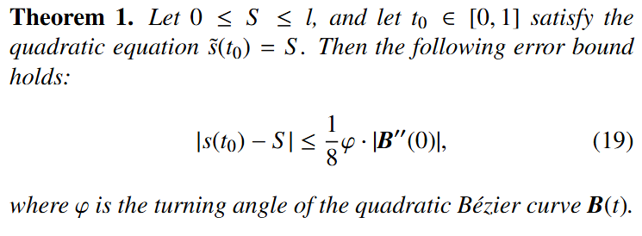

Method: Efficient Arc-Length Parametrization
Error estimation: accuracy is controlled by turning angle $φ$
How accurate is the chosen initial guess?
Notes:
We analyzed how accurate this initial guess is. Theorem 1 says the accuracy is controlled by the turning angle phi.

Slide 15
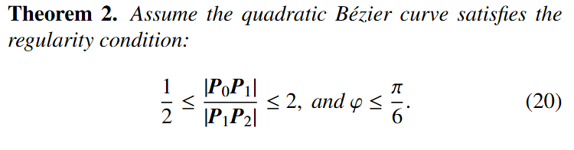
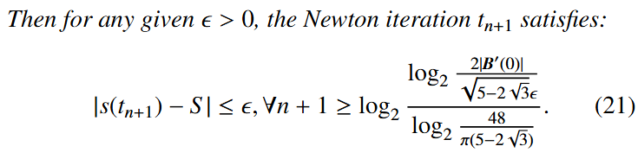

Method: Efficient Arc-Length Parametrization
Error estimation: accuracy is controlled by turning angle $φ$
How accurate is Newton iteration?
Notes:
Furthermore, in Theorem 2 we provide an explicit upper bound on the convergence steps of Newton iteration, assuming a bounded turning angle and a non-extreme control-edge ratio.

Slide 16
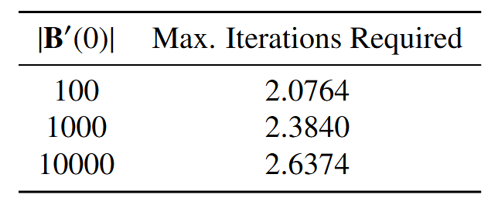

Method: Efficient Arc-Length Parametrization
Upper bound depends on $ε$ and twice control edge length |$B^{′}(0)|$
Assume $ε=0.01,$ observe how upper bound is related to |$B^{′}(0)|$
Rendering in 1920x1080 screen: ${|P}_{0}P_{1}|≤1920+1080=3000$
Newton iteration always converges within 3 steps
Upper bound of Convergence Steps
Notes:
The upper bound given in theorem 2 depends on the error tolerance and twice the control edge lengths. To understand its behavior, we assume the error tolerance to be 0.01 and we observe how upper bound varies with the control edge length, then we obtain this table, which says in practice, Newton iteration always converges within 3 steps.

Slide 17
Method: Efficient Arc-Length Parametrization
Application in dashed stroke rendering
Subdivision with bounded curvature to guarantee fast convergence
Find parameters of solid segments in each subcurve, in parallel
Result of subdivision
Result of dashed stroke rendering
Notes:
We apply the designed arc length parameterization method in dashed stroke rendering. We use subdivision with bounded curvature to guarantee fast convergence and to compute the parameter ranges of solid segments in each subcurve in parallel, again in tessellation shader.

Slide 18







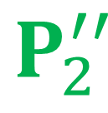



Method: Efficient Arc-Length Parametrization
Texture mapping construction:
$$ψ\left(u,v\right)={\left(1−u\right)}^{2}{(P}_{0}+\left(2v−1\right)d_{0})+$$
$$2u\left(1−u\right)\left(P_{1}+\left(2v−1\right)d_{1}\right)+$$
$$u^{2}(P_{2}+\left(2v−1\right)d_{2})$$
$$P_{1}^{′}$$
$$ψ$$
$$P_{1}$$
$$P_{0}^{′}$$
$$P_{1}^{′′}$$
$$P_{2}^{′}$$
$$P_{0}$$
$$P_{2}$$
$$P_{0}^{′′}$$
$$P_{2}^{′′}$$
Unit square in $uv$ texture space
Stroke region
Arc-length-guided texturing: uniformly partition the region to reduce distortion
Notes:
We also solve the problem of texture filling for the stroke region. We construct the texture mapping as follows, /*the overall idea is to parameterize the stroke region as a family of quadratic curves. Then*/ the texture filling problem amounts to solve the inverse mapping of psi, again we use the Newton iteration.
/*In general distortion will be introduced if the arc length and width of the stroke region doesn’t match.*/ Another application of the arc-length parameterization is to uniformly partition the region to have aspect ratio 1 to reduce the distortion introduced by texture mapping.

Slide 19

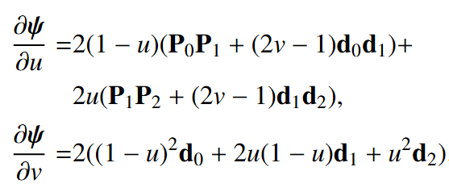

Method: Efficient Arc-Length Parametrization
Texture coordinate solving
Given pixel coordinate $P=\left(x,y\right),$ require $\left(u,v\right) s.t. ψ\left(u,v\right)=(x,y)$
Newton iteration-based solving, with piecewise linear initial value $\left(u_{0},v_{0}\right):$
Explicit Jacobian matrix computation:

Slide 20
Results
1
Subdivision from Polar Stroking, 38 trapezoids in total
Our subdivision, 6 quadratic strokes
Notes:
This is a comparison between our subdivision method and the previous work that uses trapezoids to approximate the stroke region. So it requires a lot more primitives than ours.

Slide 21
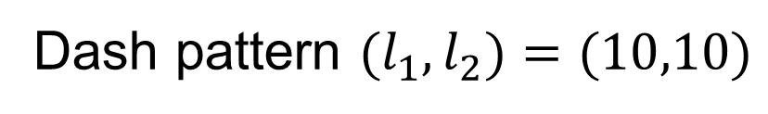
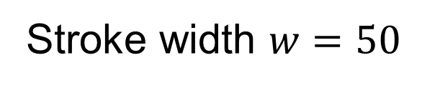
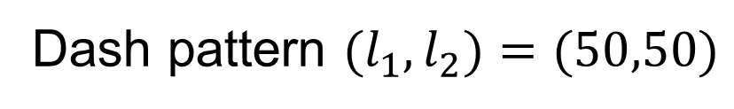
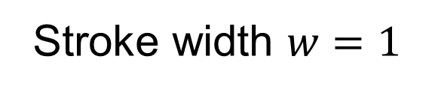
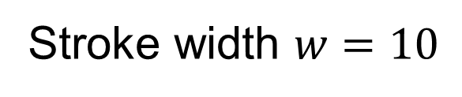
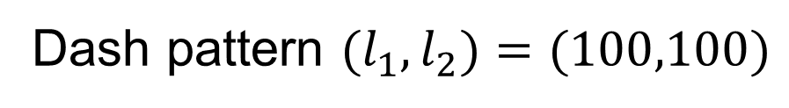
Results
Stroke width $w=50$
Stroke width $w=10$
Stroke width $w=1$
Dash pattern $(l_{1},l_{2})=(100,100)$
Dash pattern $(l_{1},l_{2})=(50,50)$
Dash pattern $(l_{1},l_{2})=(10,10)$
Notes:
Here are our rendering results for strokes with different widths and different dash patterns.

Slide 22
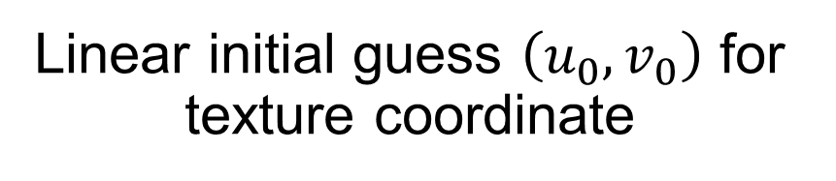
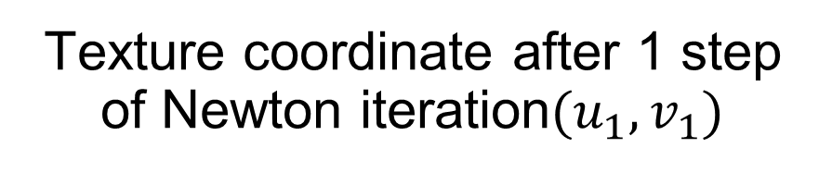
Results
Arc-length guided texture filling
Linear initial guess $\left(u_{0},v_{0}\right)$ for texture coordinate
Texture coordinate after 1 step of Newton iteration$(u_{1},v_{1})$
Notes:
This is our texture filling result.

Slide 23
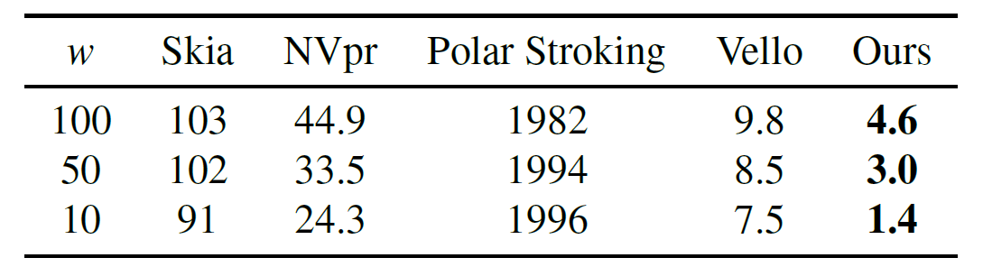
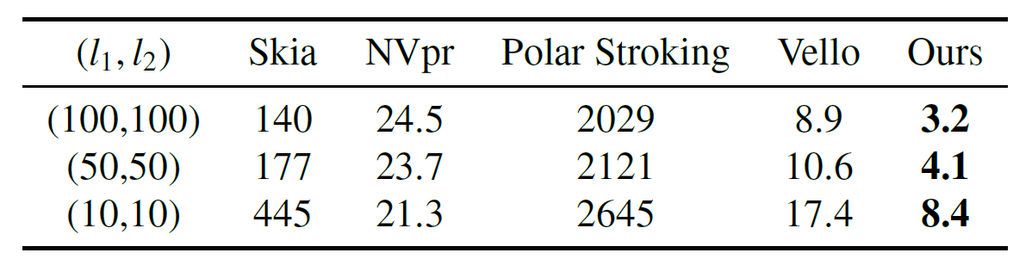
Results
Speed comparison(ms), average speedups of 3.4x(solid), 2.5x(dashed)
Average rendering time (ms) for solid stroke paths
Average rendering time (ms) for dashed stroke paths
Notes:
Here is the comparison of speed. Our method obtains average speedups of 3.4 times for solid stroke and 2.5 times for dashed stroke, over the existing method.

Slide 24
Conclusion and Future Work
Conclusion:
We propose a GPU-accelerated rendering method of quadratic strokes
Combine implicit equation-based rendering and curvature-guided subdivision
We develop an efficient arc-length parameterization method
Guaranteed fast convergence, applicable for dash and texture filling
Future work:
Deal with hardware limitation in tessellation shader
Support more complex paths, SVG stroke styles (joins, caps, etc.)
Notes:
In conclusion we propose a GPU accelerated rendering method of quadratic strokes, where we combine the efficiency of the implicit equation-based rendering and the accuracy of curvature guided subdivision.
We also develop an efficient arc-length parameterization method with guaranteed fast convergence and applicable for dash and texture filling.
In future work we plan to deal with the hardware limitation in tessellations shader. /* Currently we use tessellation shader for the dashed stroke rendering but there are a maximum number of allowable tessellated segments, so we can only render like at most 32 dashes per subcurve. */
On the other hand we plan to support more complex paths and SVG stroke styles like joints and caps etc. this might involve decomposing paths into curvature bounded quadratics and conduct an error analysis.

Slide 25
Thank you!
Xuhai Chen, 19020230157197@stu.xmu.edu.cn
Notes:
So this is my talk, thank you. Do you have any questions?

